Slide 1
Product Design Practice INT303 - April 2022
Bio Gas Digester
B1-18
CED19I056 : Nandita M
EDM19B005 : G Madhu Teja
MDM19B007 : P.V.P.Sai Namruth
MDM19B034 : B.Anupama Sai

Slide 2
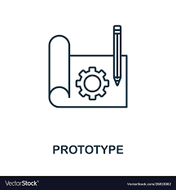
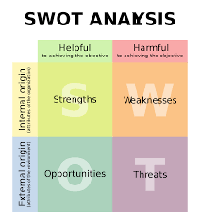
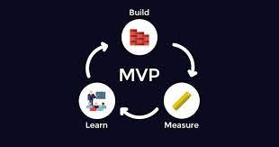


Roadmap
Ideation and Solution Implementation
Business plan and Market Analysis
BOM,MVP,PO
SWOT and VCA
Prototype or 3D model

Slide 3


Introduction
The demand of energy has been increased over the years as the sequence by increasing of the world population .Fossil fuels are exhausting and the emission products of these fuels have been causing some damages to the environment.
Bioenergy is an energy obtained from any fuel that is originated from biomass, which includes recently living organisms and their metabolic by-products
Biofuels are eco-friendly and renewable resources of energy
Biogas technology is used to convert the organic waste into energy. The use of energy and manure can lead to social economic benefits, green environment, and also contributes towards sustainable development Biogas technology is also a source of nutrient-rich organic fertilizer.
Biogas generation serves three important functions: waste removal, environmental management, and energy production. The first and most direct use of biogas is for heating and domestic purposes .
This Photo by Unknown Author is licensed under CC BY

Slide 4
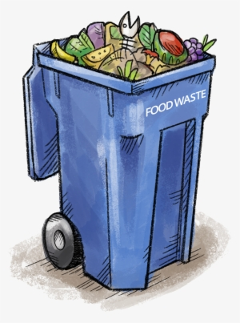
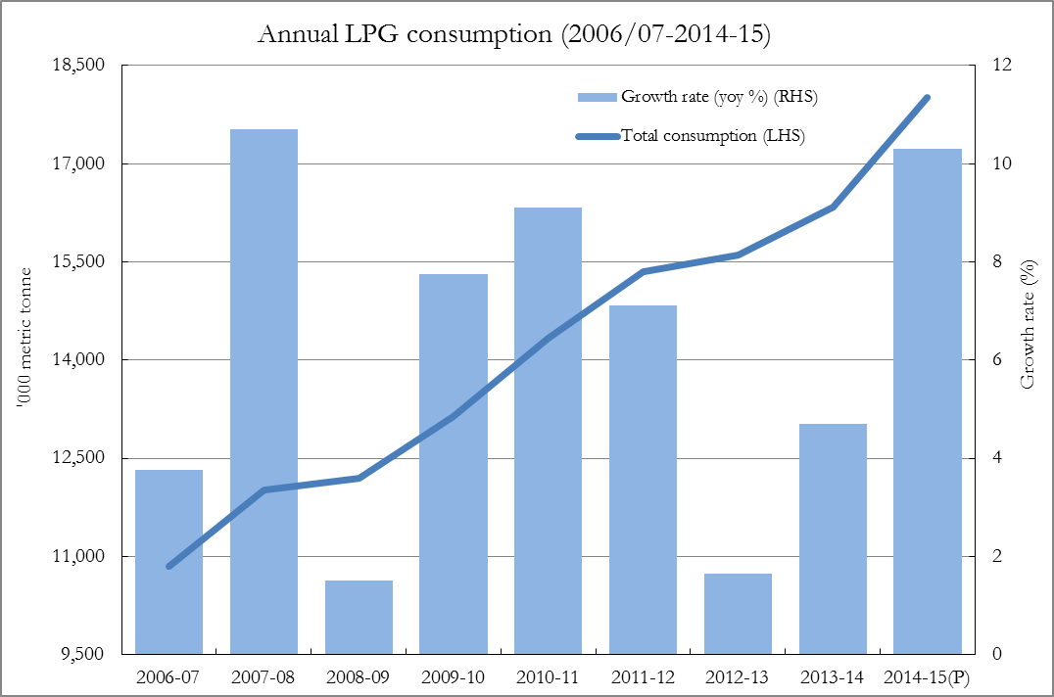
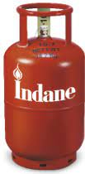
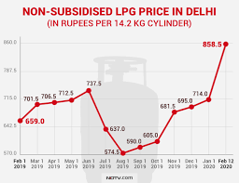
Problem Statement
Kitchen waste ends up in landfills
Low reserves of LPG gas
Increased usage of non-renewable resources
Increased Cost of LPG/ Cooking gas cylinders

Slide 5

Business Strategy
Awareness
Creating a special program in every locality to show how easy and important it is to use our product.
Acquisition
Appeal to a larger customer base by teaming up with Non-Govt Organizations.
Credibility
We plan on partnering with existing biogas producers to update our technology
Reliability
We can provide warranty for out product through which we can gain the trust.
Referral
Post good customer reviews and success stories on our website to attract customers.

Slide 6
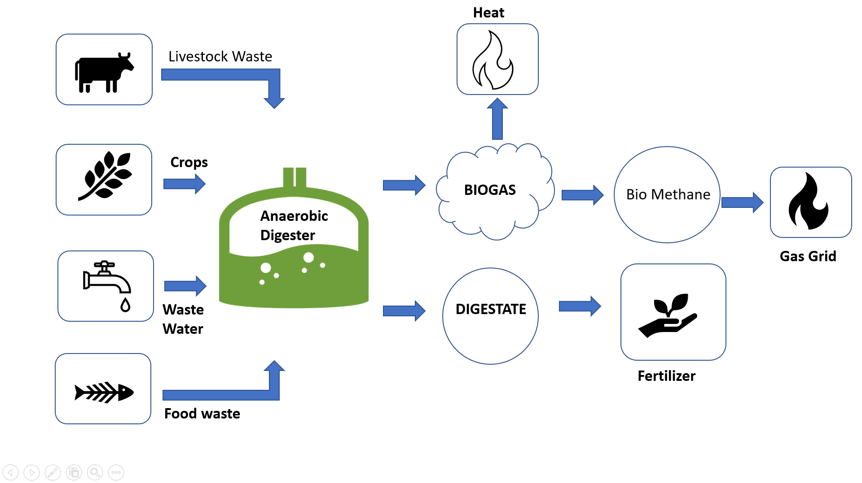
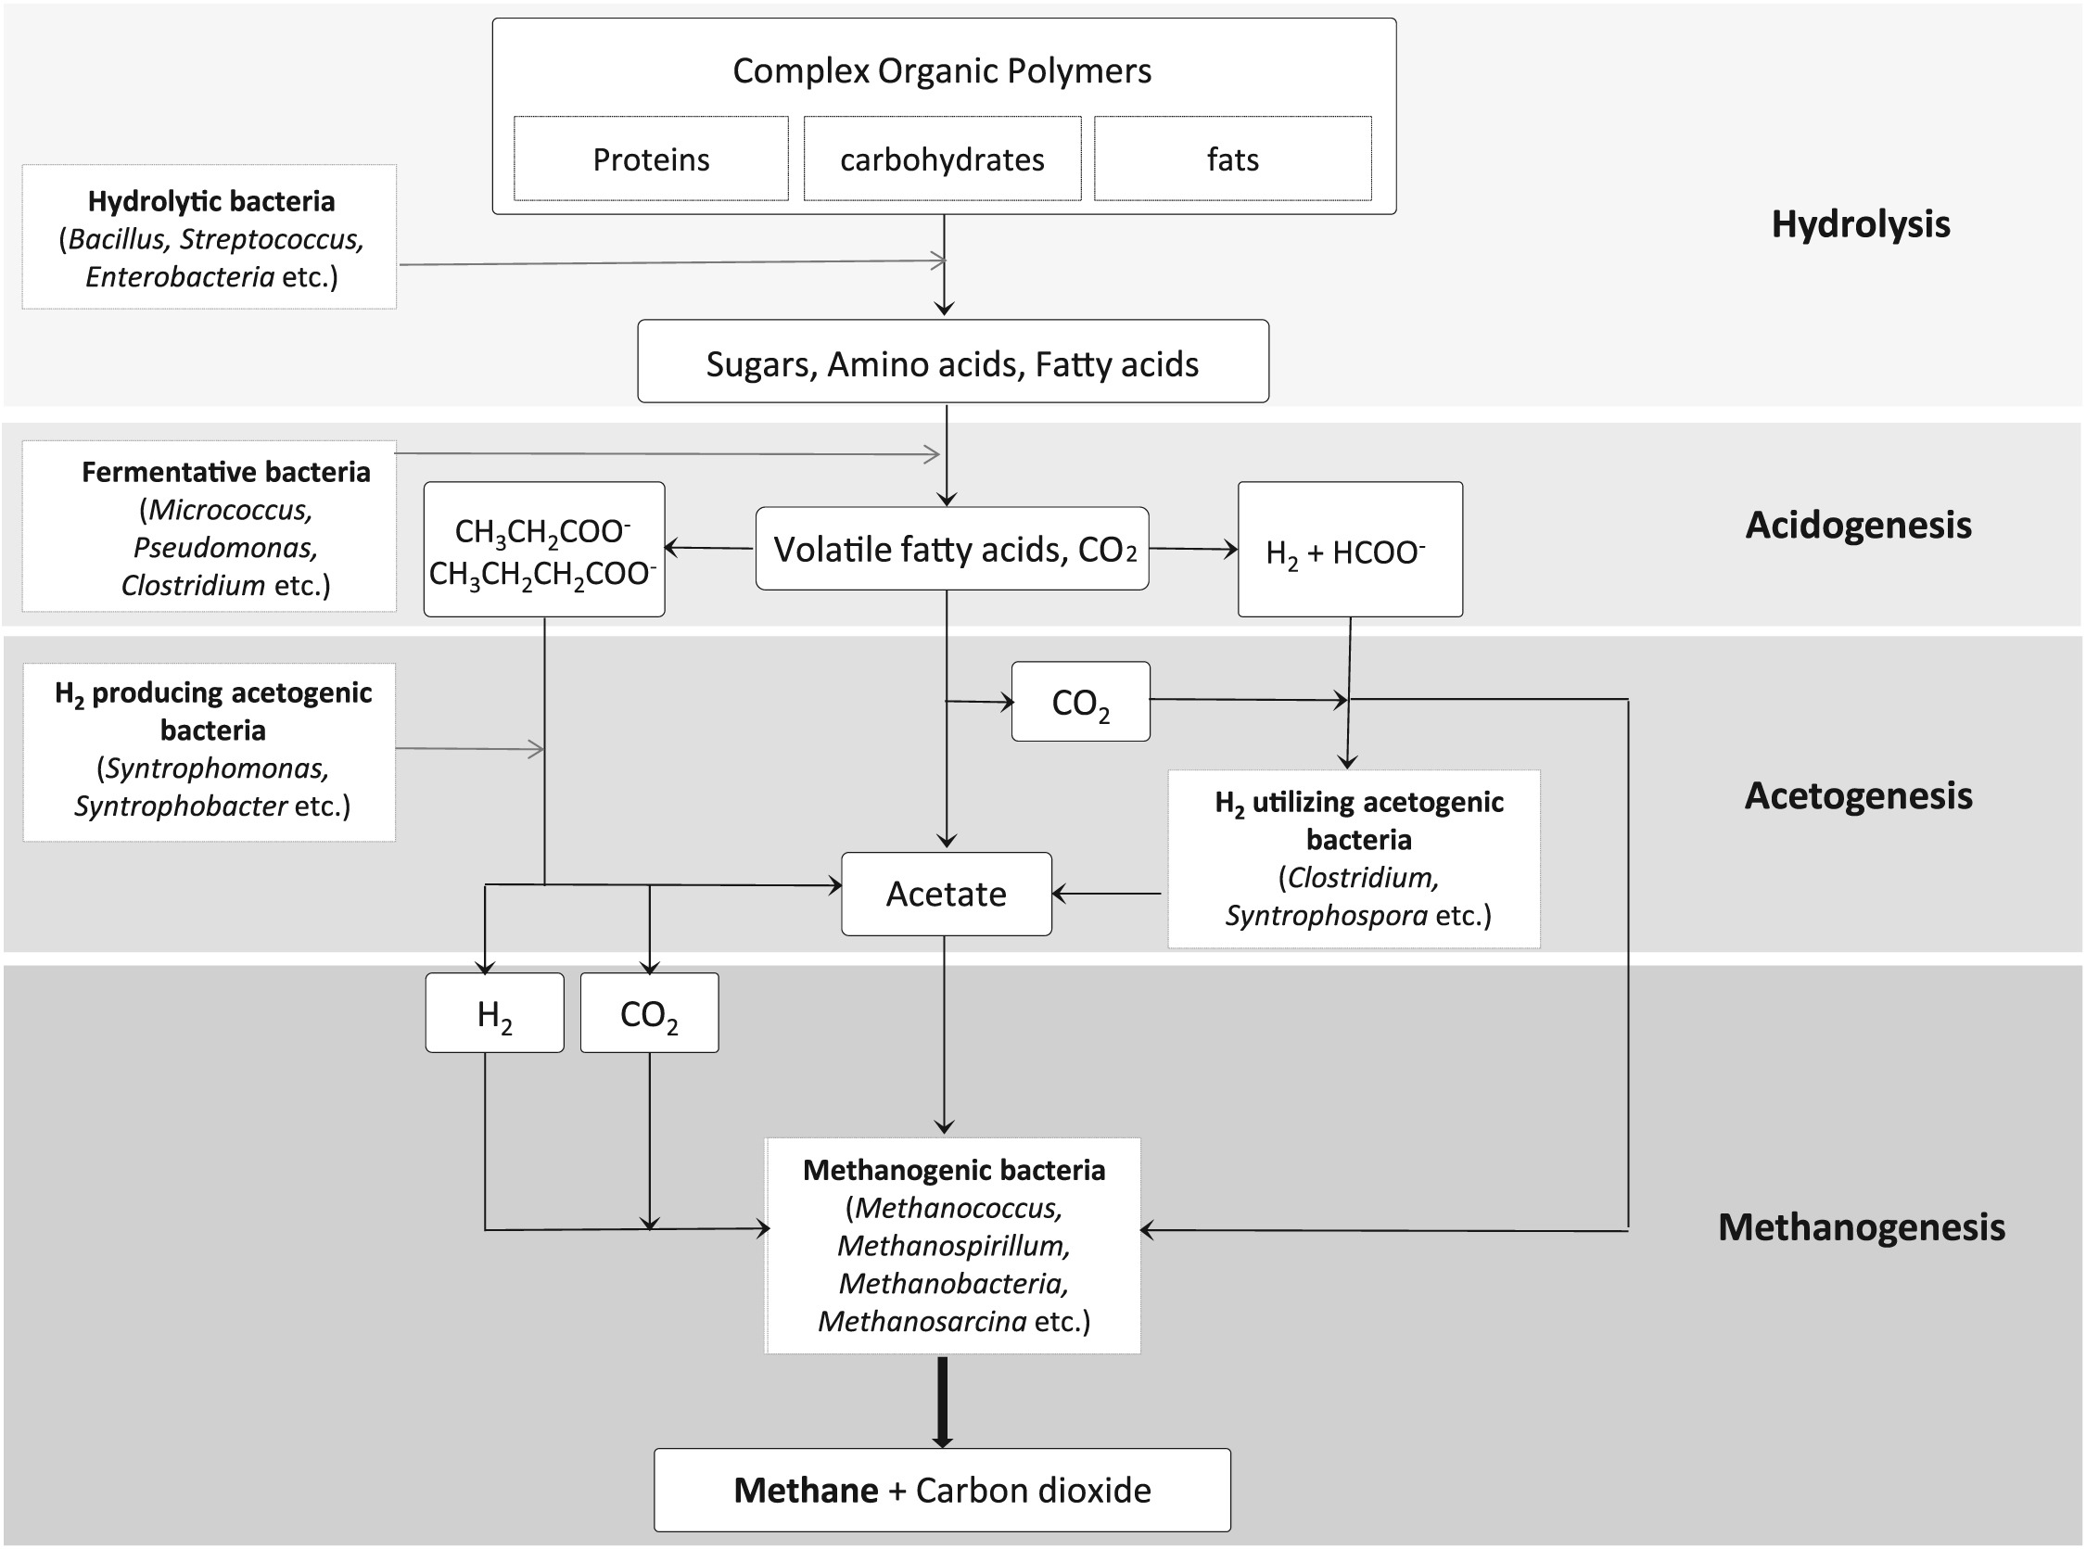
Methodology and Function
Working Process
Working Principle

Slide 7
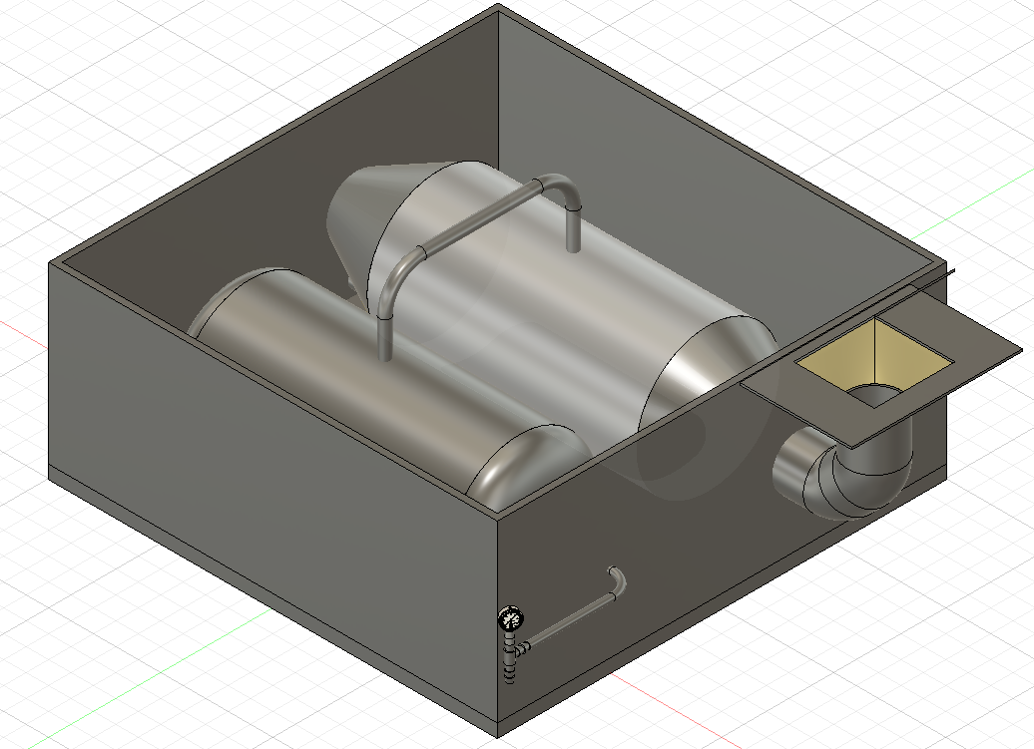
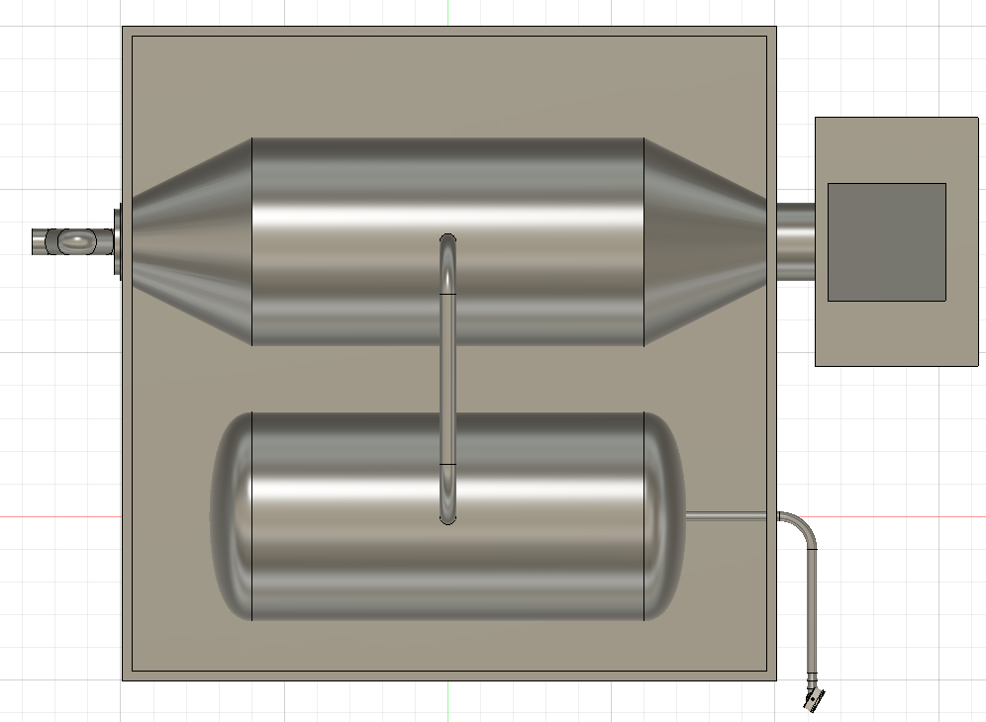
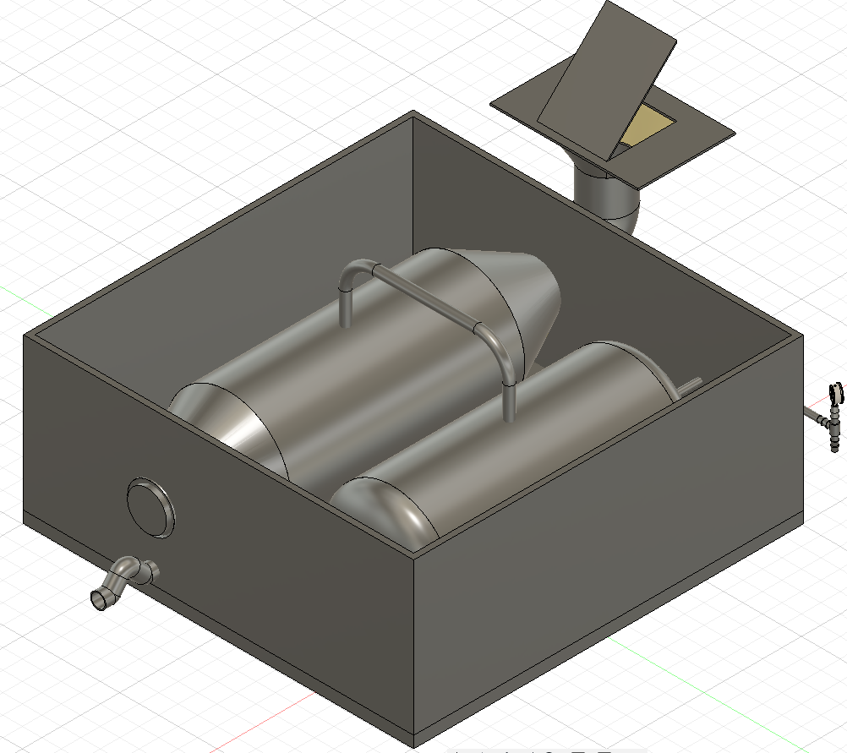
3D Model
Left Isometric View
Top View
Right Isometric View

Slide 8
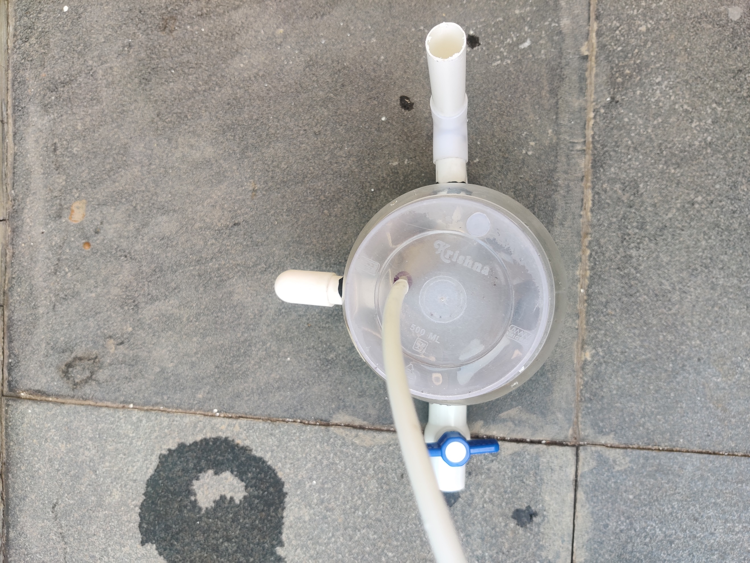
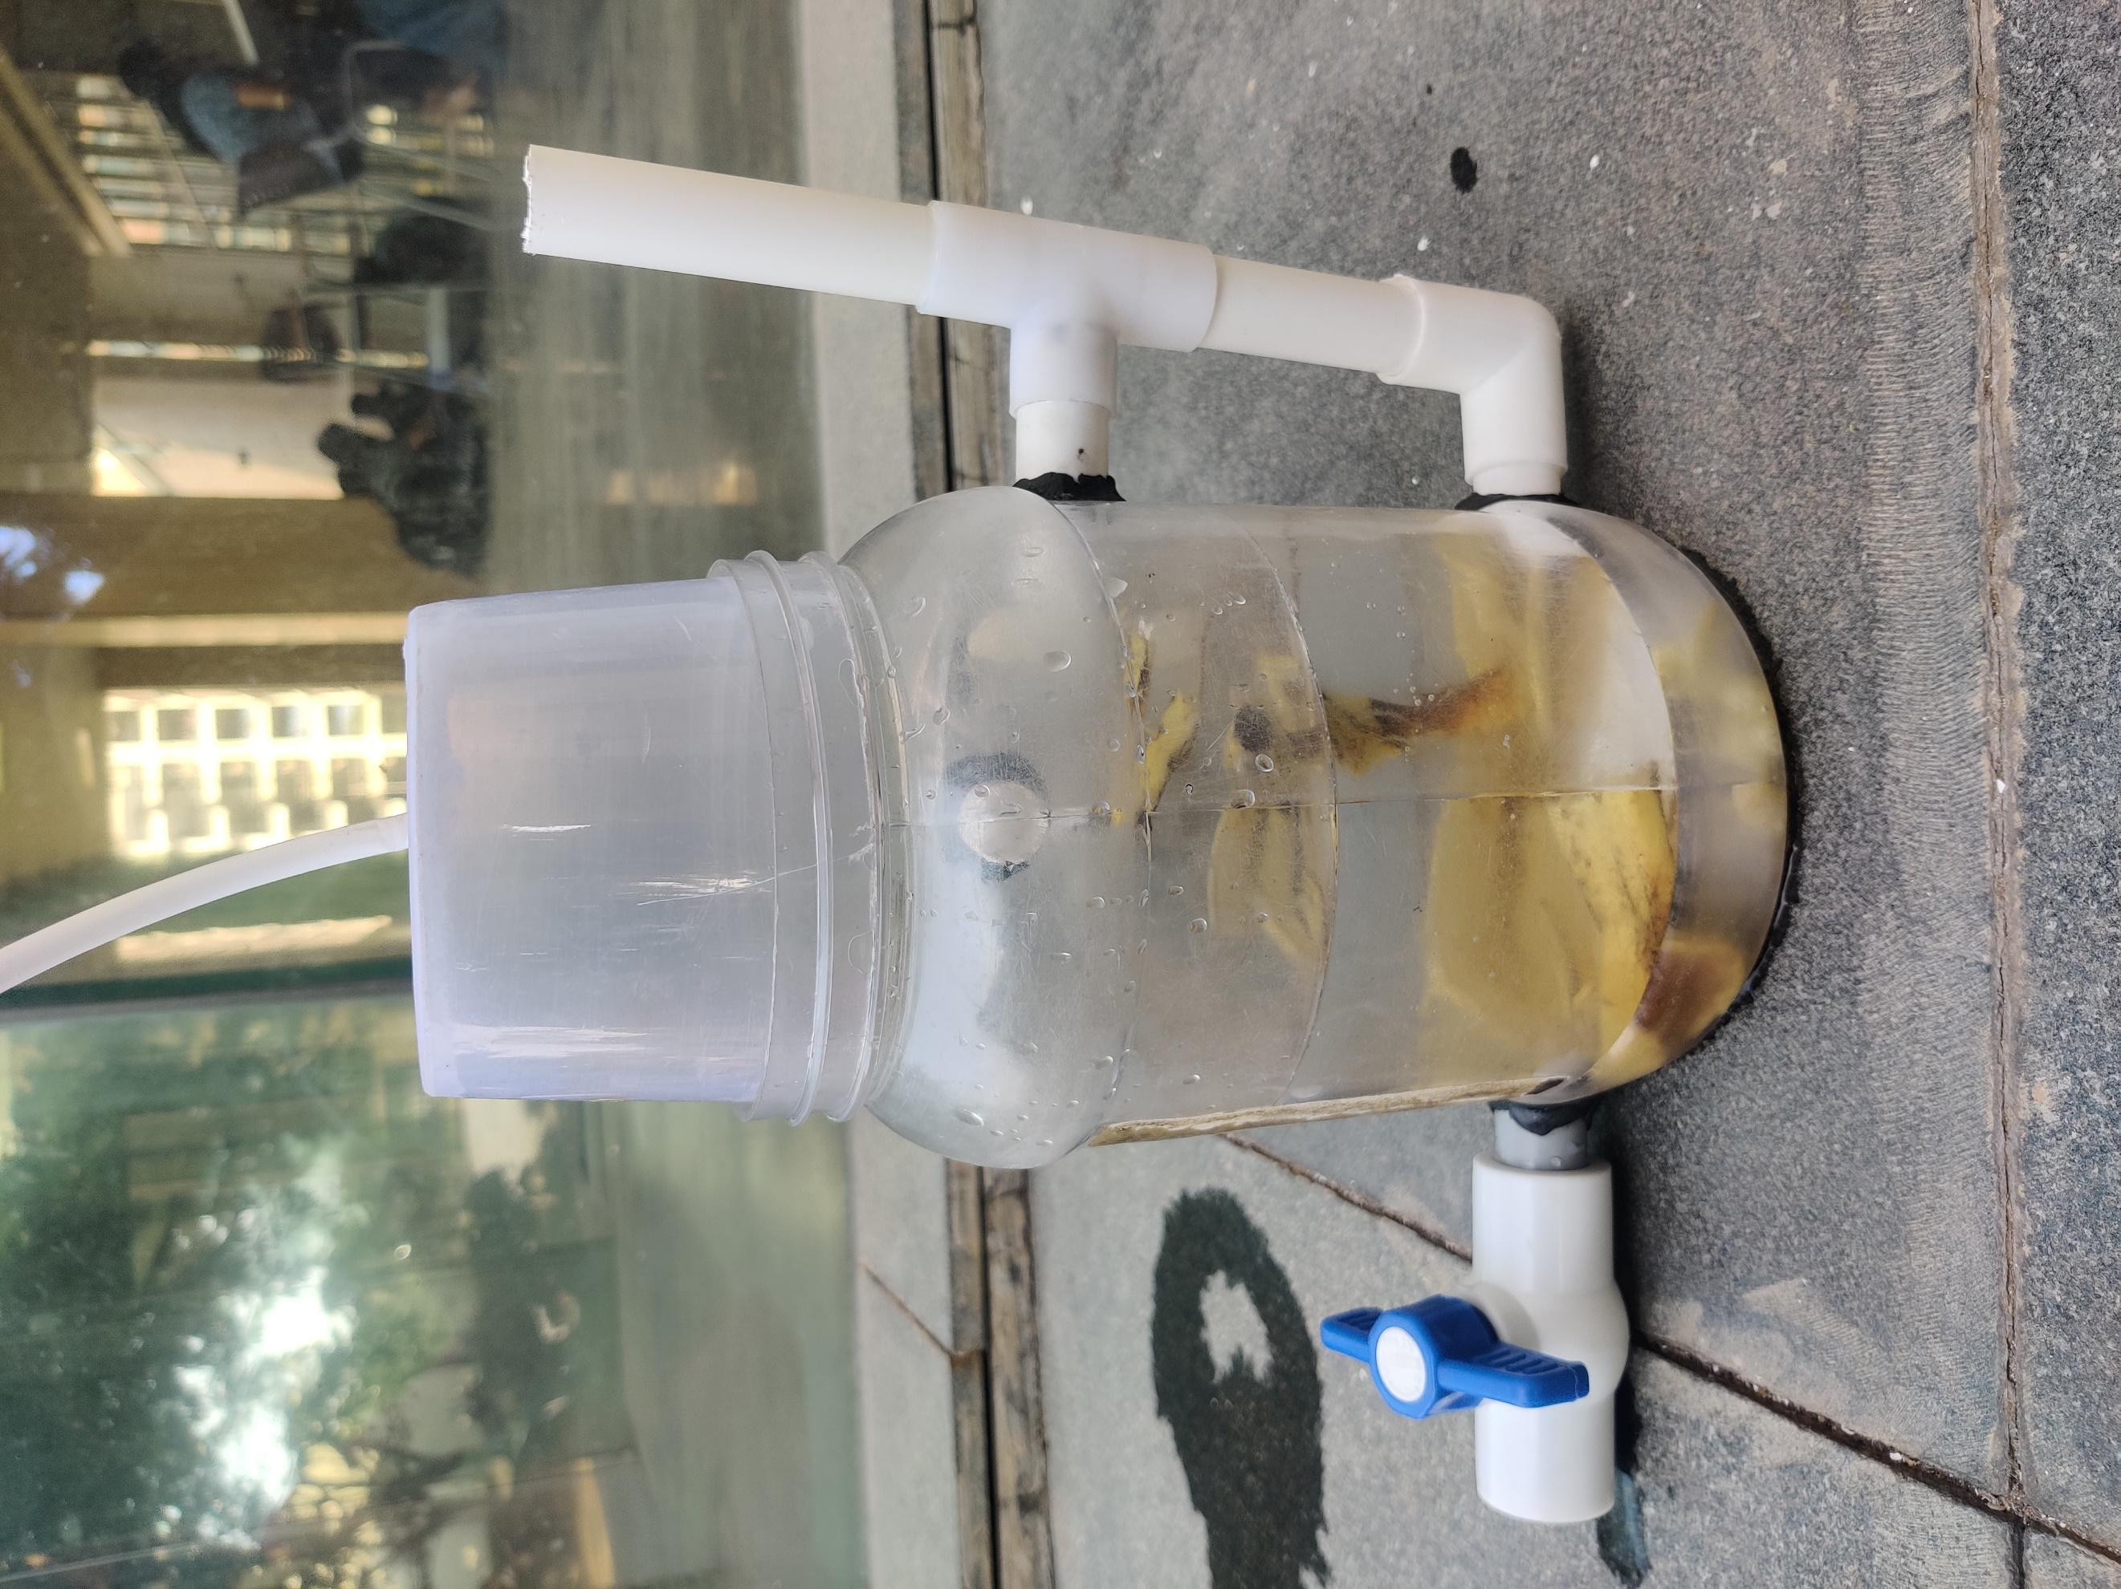
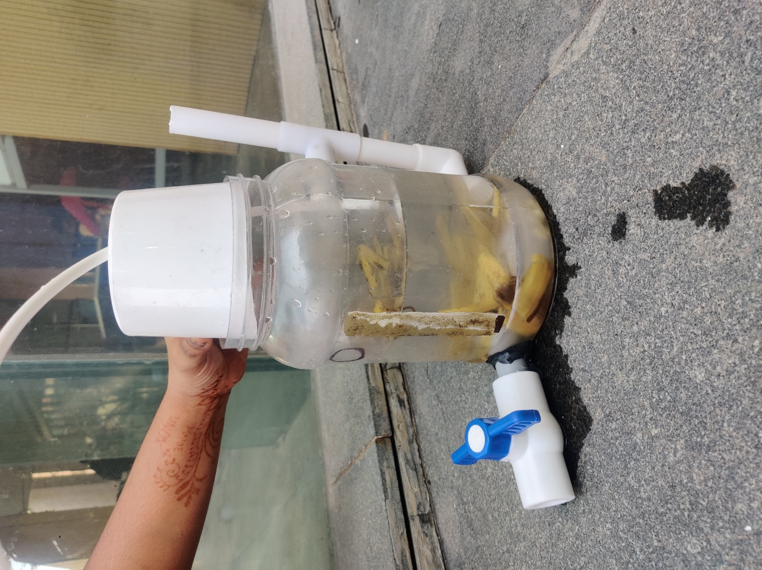
Prototype

Slide 9
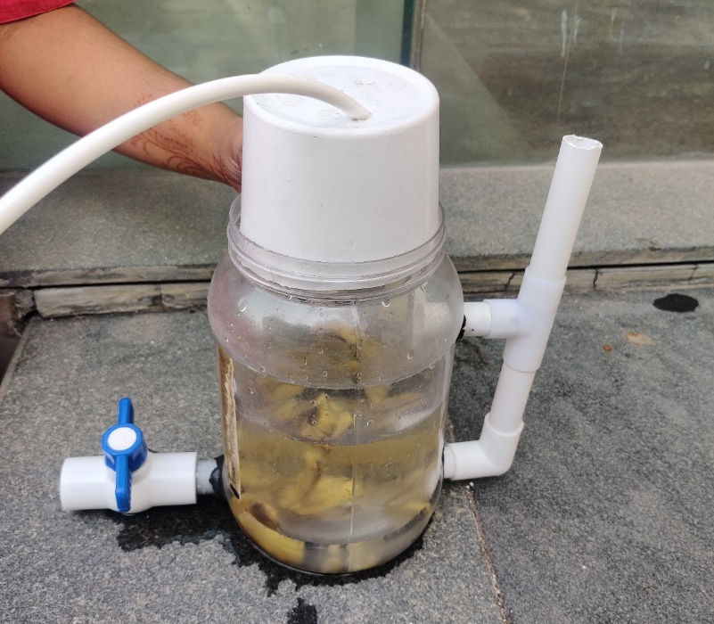
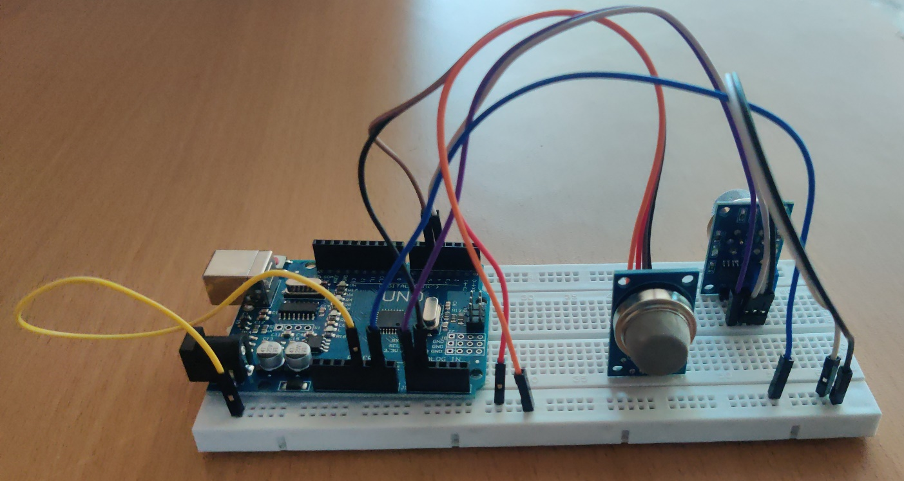
Contd.
The electronic components here in the image are two sensors. One is MQ2 sensor i.e, it detects the presence of methane gas. UNO board acts as the interface for all the sensors.

Slide 10
Results
Requirements
1 L LPG = 1.05 m3 of biogas. 1 kg LPG = 2.1 m3 of biogas.
LPG to Biogas Comparison
1kg if well digested, it yields 0.3m³
1 cylinder(14.2kg of LPG) can be used for 1.16months.
We produce 0.887kg of waste per day which equals 0.887*0.3= 0.2661m³ of biogas.
Therefore to satisfy this we need to produce 14.2*2.1 m³ biogas=29.82m³ Per 1.16 months to get uninterrupted gas.
This means we can produce 3.201 times less biogas than required with waste generated per day. 29.82m³/35days = 0.852m³/day has to be produced.
So we can use our biogas digester 11 days a 1.16 months.
In order for these bacteria to work properly and achieve the desired end products, the following conditions have to be well balanced
The dilution of the substrate i.e. amount of water to dilute the animal waste.
The optimum temperature should be 35 °C.Type of substrate (due to their suitable carbon to Nitrogen (C: N) ratio and total solid content cattle, pig and poultry manures are recommended).
Rate of feeding the digester (overfeeding can lead to accumulation of volatile fatty acids).

Slide 11
Future Enhancement
Use of Solar Panel for maintaining the temperature of the digester
We can use solar panel for all the energy requirements of the digester
App dedicated for monitoring the Gas available
Here the user can make use of the app for knowing the how many days the gas will last for approximately.
Automation of manual processes of filling water and calculate the time required to digest the waste
The double locking mechanisms like using butterfly valve technique can be used at the inlet to reduce the release of the bad smell from the inlet opening.

